Slide 1
NodeJs Session
By
Sashidharan Kanagaraj

Slide 2
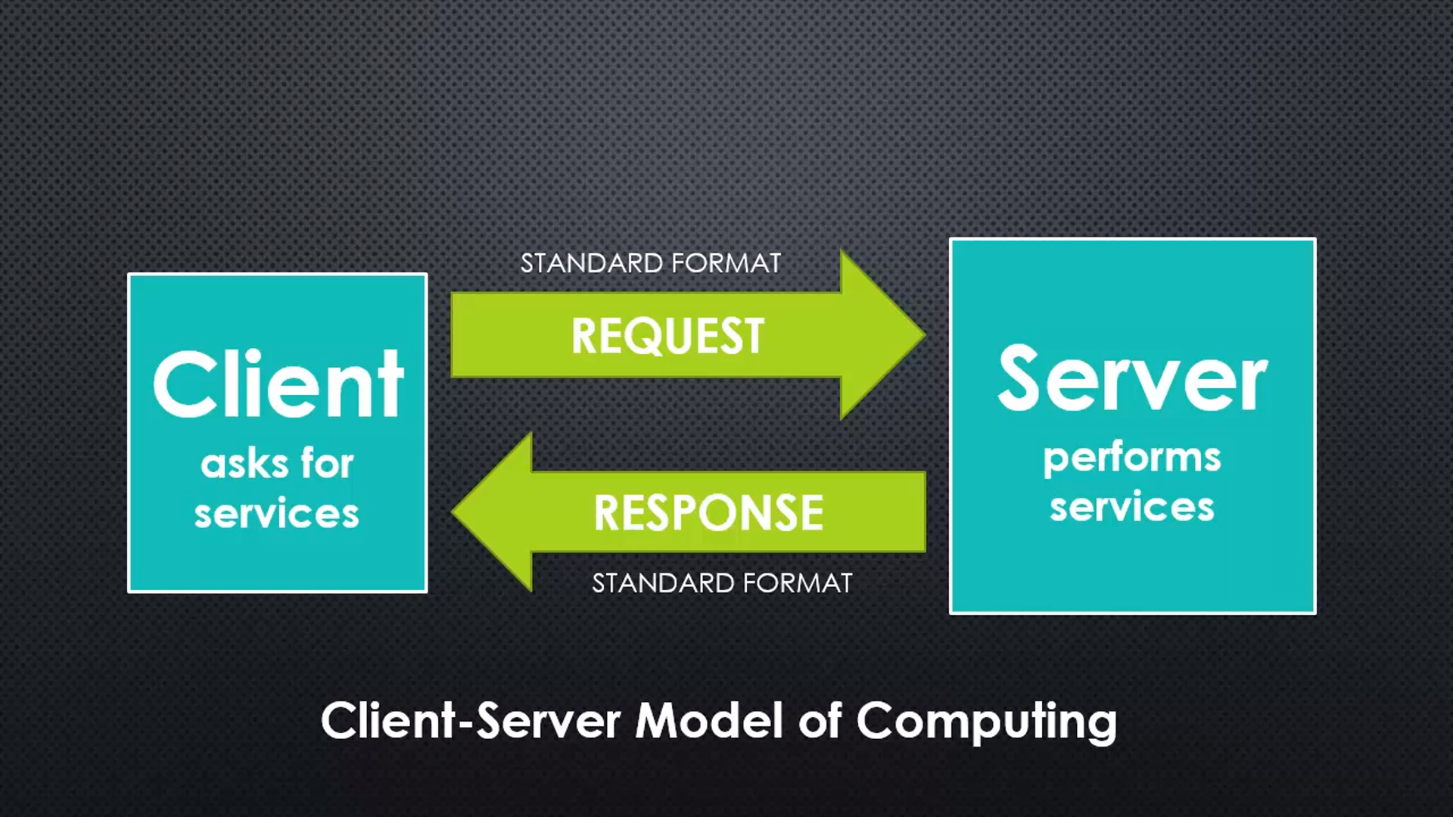

Before Nodejs
Web applications were written in a client/server model.
Server only responded when client requested and would close the connection after each response.
If the millions of requests coming in at the same time, servers would be delayed till all other requests were responded to.
Good News, Threads are a way for systems to run multiple operations concurrently.

Slide 3
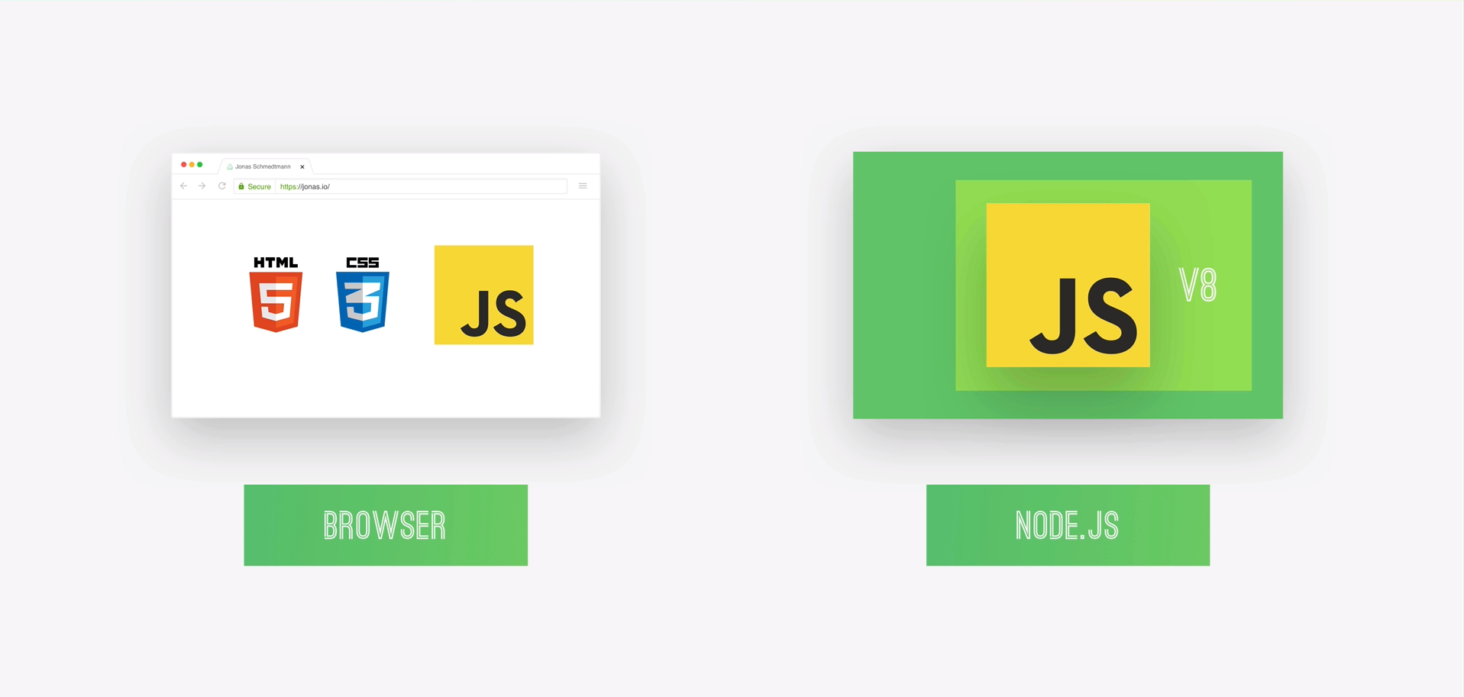
What is NodeJs
Chrome’s V8 JavaScript engine.
Asynchronous & Event-driven Programming.
Non-blocking I/O model.
NPM - open source libraries.
Single Threaded.

Slide 4
Why NodeJs
Open Source
Fast-processing
Scalable for microservices
Seamless JavaScript & JSON support
High performance and low-cost technology
No Buffering

Slide 5
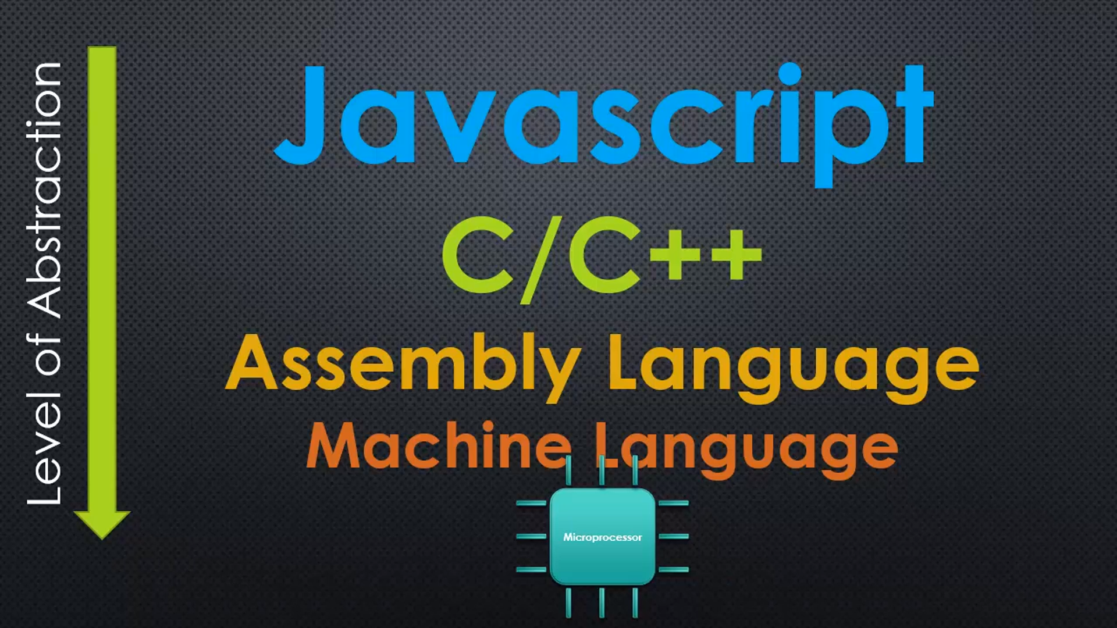
V8 Javascript
Open source runtime engine written in C++.
V8 implements a script called ECMAScript as specified in ECMA-262.
ECMAScript was created by Ecma International to standardize JavaScript
V8 can run standalone or can be embedded into any C++ application

Slide 6
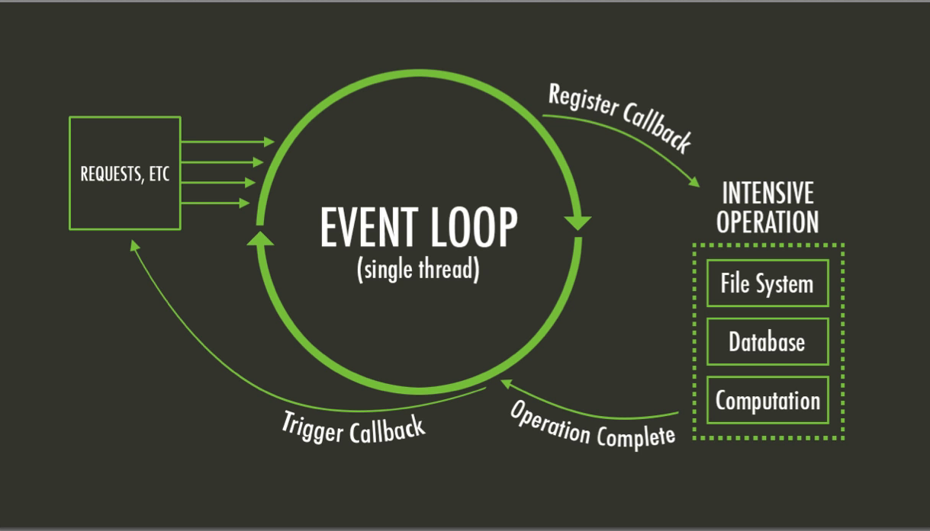
Event Loop

Slide 7
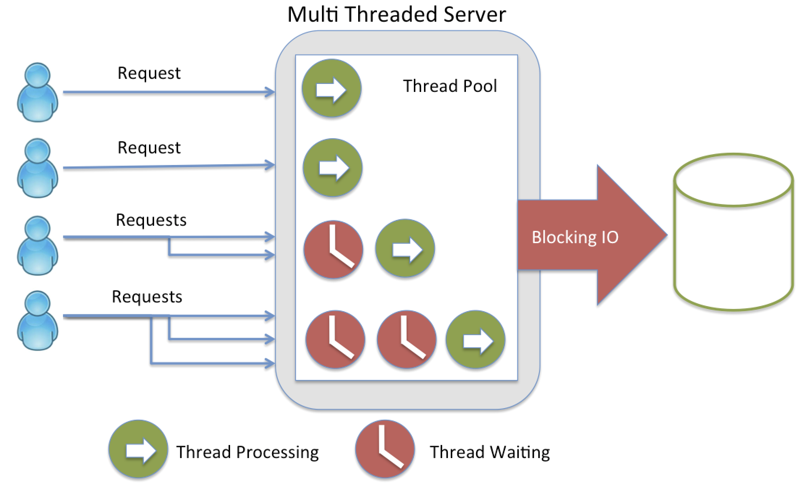
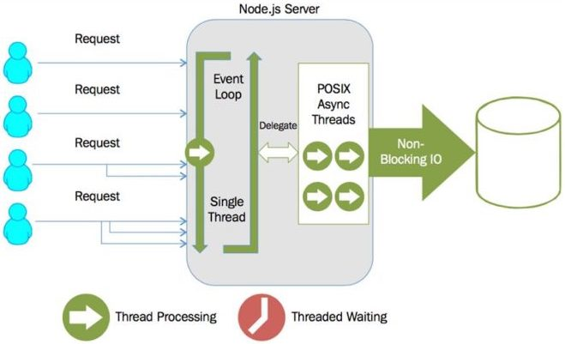
Blocking Vs Non-Blocking I/O

Slide 8
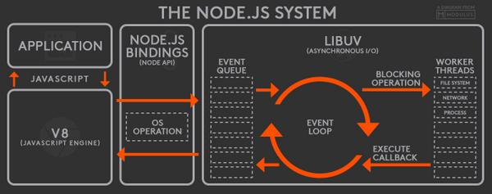
NodeJs System

Slide 9
NPM
Libraries which built by the awesome community which will solve most of your generic problems.
The packages you can use in the app make development faster and efficient.
Publicly available, reusable components, available through easy installation via an online repository, with version and dependency management
Some most important modules are:
Express, socket, mongodb, http, connect, passport, etc….

Slide 10
Where to use NodeJs
Real Time Web Application
Online Browser Games, Chat Application
Single Page Application
Network Application
Data Streaming, Video & Audio Streaming
JSON API based Application

Slide 11
Where Not to Use
CPU intensive applications

Slide 12
NodeJs Installation & Environment Setup
Download latest version of Node.js installer.
Use the MSI/EXE file and follow the prompts to install the Node.js
Installer uses the Node.js distribution in C:\Program Files\nodejs.
Installer set the C:\Program Files\nodejs\bin directory in window's PATH environment variable.
To Check the installation, type the below command
node --version / node –v
- Displays version of the nodejs

Slide 13
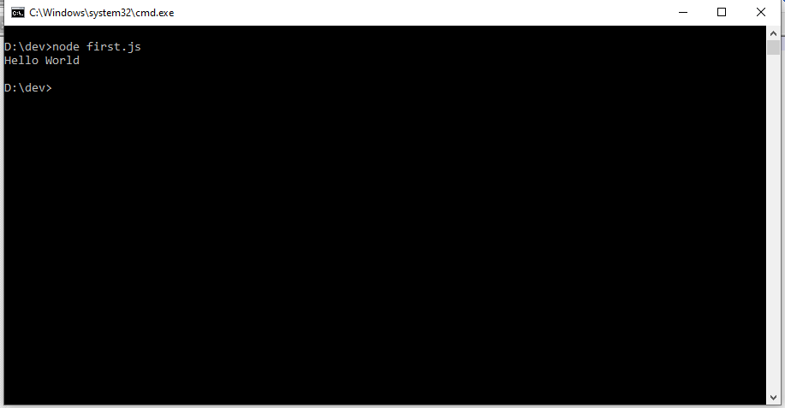
First Node Application
Create a file named as: first.js
Open first.js and type the command as follows:
console.log(“Hello World”);
Now run the command as : node first.js

Slide 14
Assessment
Try Any Five Default Node api modules in you application from the below url.
https://nodejs.org/dist/latest-v13.x/docs/api/

Slide 15
Queries

